Slide 1

Evaluating LLM, RAG, and Multi-RAG Models in Langflow: Insights from Langwatch
Author: Andrea Sorbello
Supervisor: Prof. Simone Palazzo
Co-Supervisor:
Prof. Giovanni Bellitto

Slide 2
Introduction
Context: Natural Language Models (LLM) are powerful but limited by static information.
Problem:Traditional LLMs can't access real-time data.
Proposed solution: RAG and Multi-RAG models use information retrieval to improve responses.

Slide 3
Goals
Main purpose: To compare the performance of three approaches to natural language generation.
Approach
Metrics
No-RAG: Model without external retrieval
Single-RAG:Model with single-source retrieval
Multi-RAG Model with multiple source retrieval
Correctness
Relevance
Response Time

Slide 4
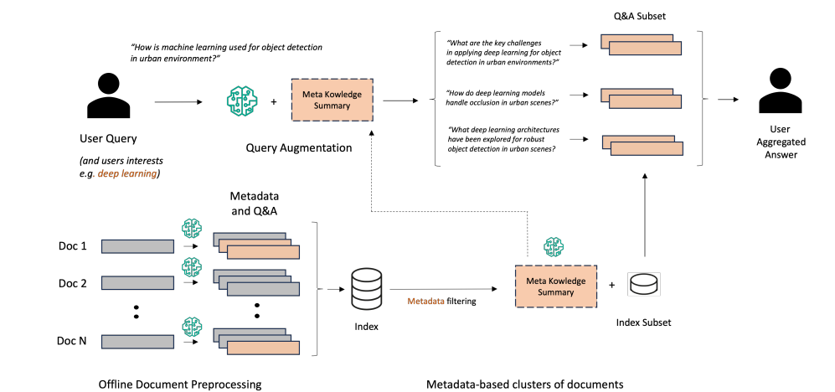
State of Art
Advanced ‘'Prepare-then-Rewrite-then-Retrieve-then-Read’ workflow Metadata integration: Generation of synthetic question-answers to improve retrieval accuracy and recall

Slide 5


No-RAG Model
Architecture: pure LLM model, without using external data for information retrieval.
Limitations: Less precise and relevant answers.
Prompt
Response
Combine question + context into prompt
Large Language Model

Slide 6

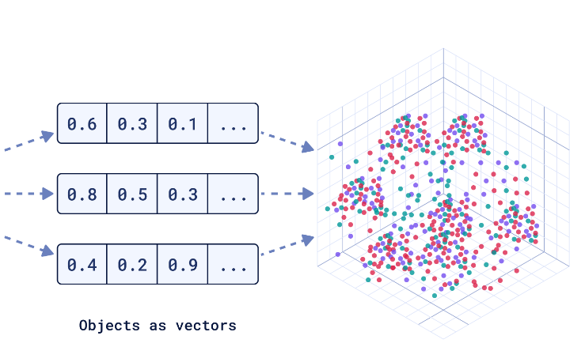
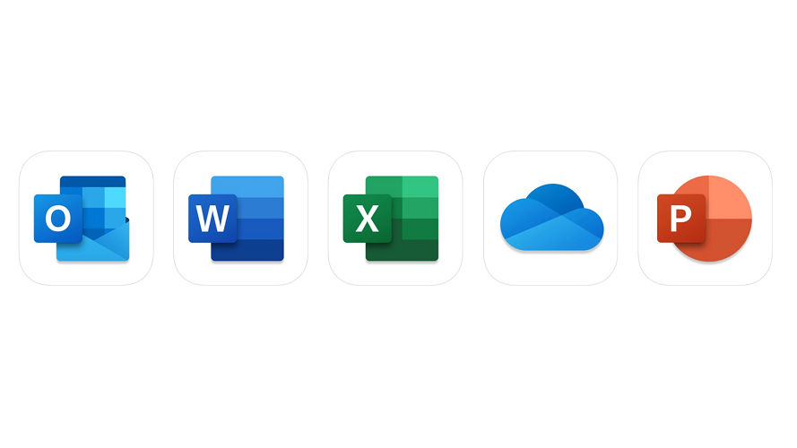




Single-RAG (Architecture e Document Ingestion)
Architecture: LLM model with information retrieval from a single source .
Chuncks
Extract Text
Split Text
Documents
Text
Vector Databse
Embedding
Generate Embedding
Question Embedding
Search
Retrivial
Response
Vector Database
LLM

Slide 7
Multi-RAG Model
Architecture: Model combining information retrieval from multiple sources.
Advantages: More accurate and contextualised responses.
Disadvantages: Higher latency in response time.
Search
Retrivial
Question Embedding
question is sent to the LLM, which generates multiple related queries based on it.
Vector Database
Question Embedding
Search
Retrivial
Response
LLM
Vector Database
LLM
Question Embedding
Search
Retrivial
Vector Database

Slide 8
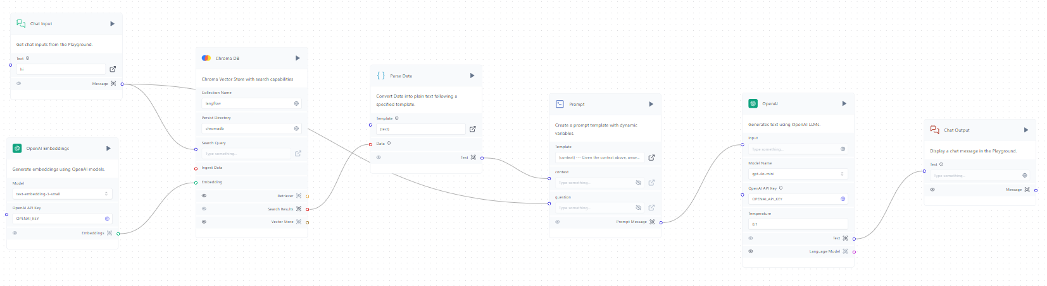
Tools used:
Langflow: Orchestration and workflow management.
ChromaDB: Vector database for information retrieval.
Openai - embedding: Used to convert the input text into embeddings for search and retrieval.
LLM (ChatGPT-4o-mini, Gemini 1.0 Pro): Language models used to generate responses.

Slide 9
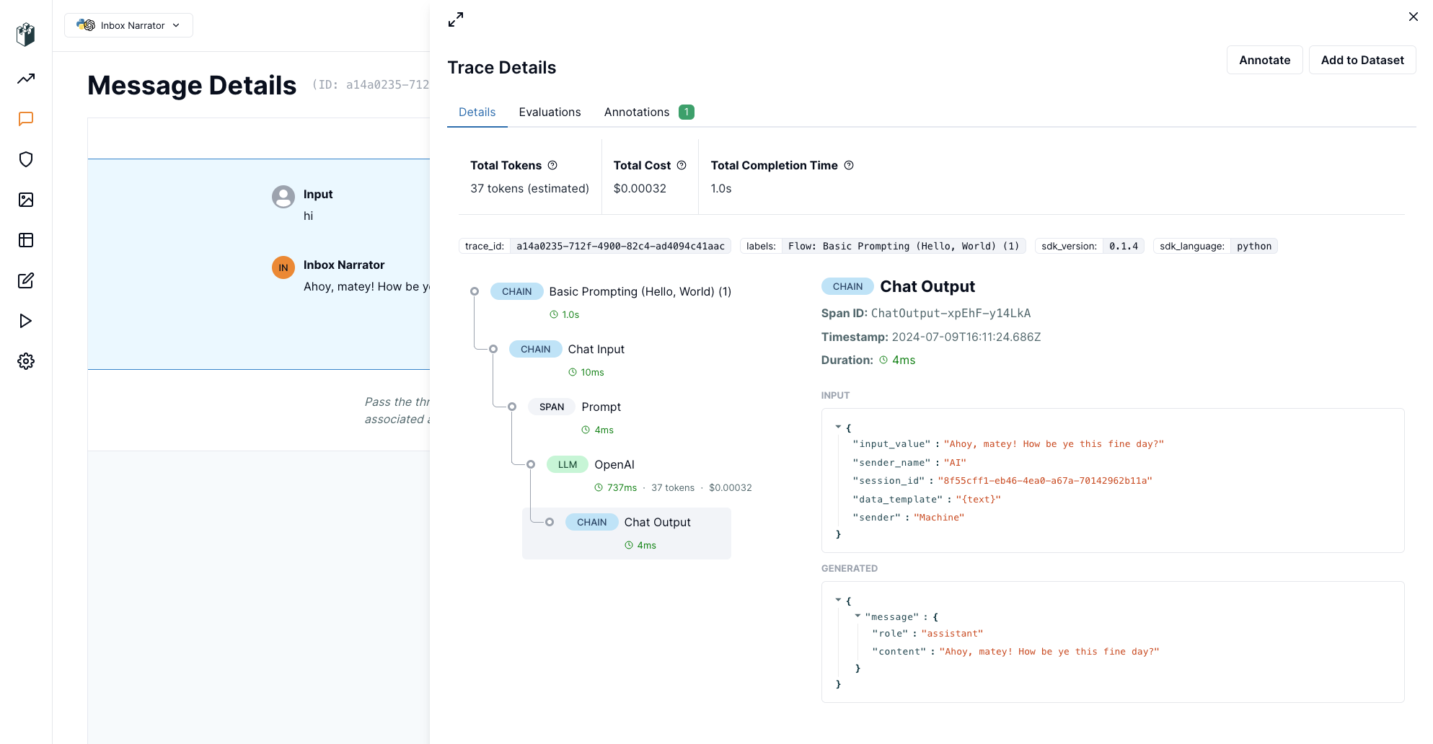
Tools used:
Langwatch: Model performance monitoring and debugging

Slide 10
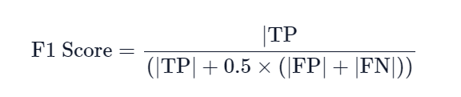
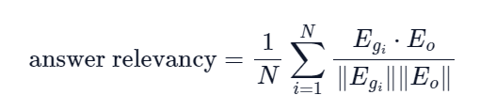
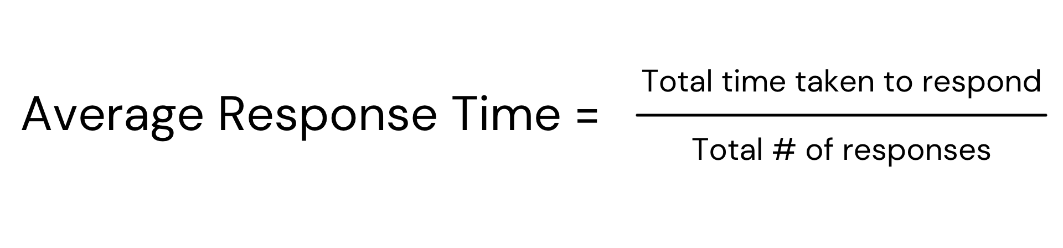
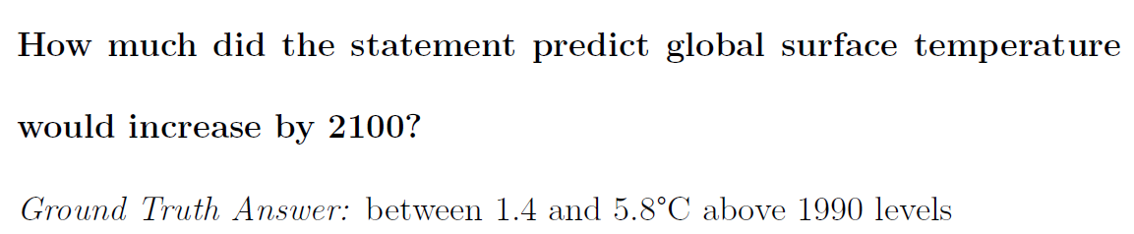
Experimental Setup
Evaluation Metrics
RAGAS Answer Correctness:
How accurately answers match the ground truth
RAGAS Answer Relevancy:
How well the answers match the context
Response TIme
Dataset
Stanford Question Answering Dataset (SQuAD v2.0)

Slide 11
Correctness Results
Model | Chat-GPT4o-mini | Gemini – 1.0 - Pro
NO - RAG | 0.25 | 0.54
SIMPLE - RAG | 0.43 | 0.76
MULTI - RAG | 0.46 | 0.78
Results for Correctness:
Best result: Multi-RAG with Gemini-1.0-pro had the highest correctness scores.
No-RAG: Lowest performance due to no data recovery.
Single-RAG: Intermediate between No-RAG and Multi-RAG.
Gemini performed better in all 3 models

Slide 12
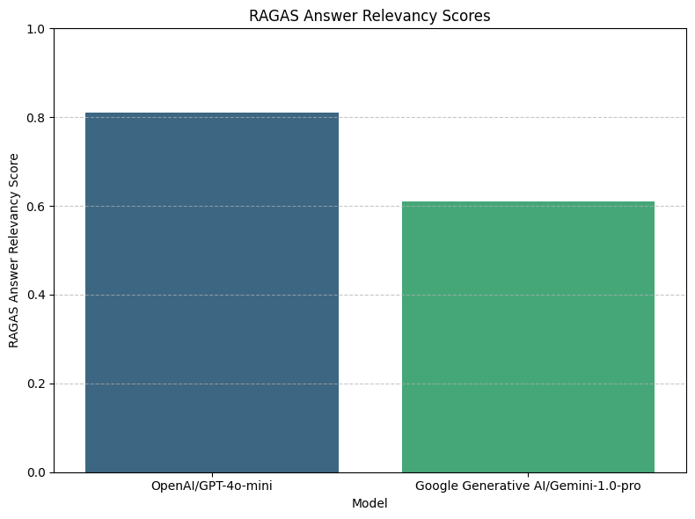
Relevancy Results
ChatGPT-4o-mini showing superior understanding of complex questions and context.

Slide 13
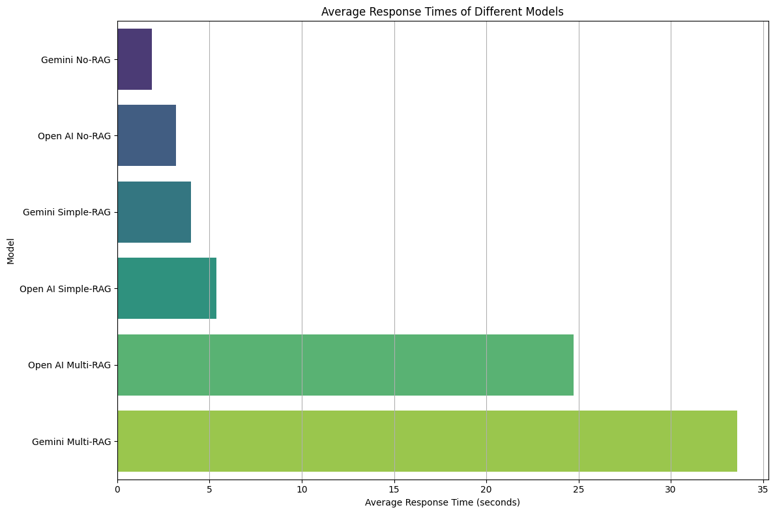
Response Time
No-RAG: Fastest response time
Single-RAG: Intermediate response time
Multi-RAG: Slowest response time

Slide 14
Conclusion
There is a clear trade-off between accuracy and response time. More complex models like Multi-RAG take longer to respond but provide higher-quality answers.
Applications:
Multi-RAG is ideal for situations where accuracy is the priority, especially in complex or dynamic contexts.
No-RAG works better when speed is critical but precision can be sacrificed.
Single-RAG strikes a balance between speed and accuracy.

Slide 15
Future Work
Optimization: Focus on optimizing retrieval processes to reduce response times, particularly for Multi-RAG models, while maintaining answer quality.
Application: Expand testing on datasets from other industries, such as legal and healthcare, where precision and context are critical.

Slide 16
Thank you for your attention
“Anyone can make the simple complicated.
Creativity is making the complicated simple.”
― Charles Mingus

